Slide 1
Coding in JavaScript – The Basics
Monday July 22: 9am – 1pm
Required software packages
Git & GitHub setup
Write your first JavaScript program
Debugging in Web Browser IDE
Commit and push code changes

Slide 2
Coding in JavaScript – The Basics
Required software packages
Monday July 22: 9am – 1pm
Visual Studio Code
Multi-language, extensible, lightweight Integrated Development Environment (IDE)
We’ll use it two write, test and debug complete JavaScript project: .js, .html, .css
Supports Git source control natively
We’ll use multiple VSCode extensions:
Live Server: web server running on your computer for debugging web projects
GitHub Pull Requests: integrates VSCode with git commands for team collaboration
Git
Source control system widely adopted in academia and industry.
Allows incremental development: small, verified code changes are keeping the whole project stable.
Allows team collaboration: multiple people contributed to same code base → open source projects.
GitHub
Cloud storage with a web-portal and functionality deeply integrated with git.
Create an account, no additional software necessary.

Slide 3

Coding in JavaScript – The Basics
Git & GitHub setup
Monday July 22: 9am – 1pm
Create a GitHub account (if you don’t have one already)
Enter a valid email address ⟩ You’ll need to confirm a code sent to that email.
Answer to “How many team members will be working with you?” ⟩ Just me
Create your own work repository
In GitHub navigate to your account icon (upper right) ⟩ Your repositories ⟩ New
Choose a name ⟩ choose Private ⟩ click Add a README file ⟩ click
In the repository dashboard click on to locate the URL (identification) for this repository.
Clone your work repository into VSCode
Open VSCode. If you have any folder opened: File ⟩ Close Folder
Click on Git ( ) pane from the left icon bar, then
Enter the URL of your repository
Choose a location on your computer where the repository should synchronize.
Congratulations! You are all setup and ready to start coding!

Slide 4
Coding in JavaScript – The Basics
Write your first JavaScript program
the Setup
In your work repository in VSCode create a “HelloJS” directory
Create three files in that directory:
Create index.html ← copy in it the content from Index.html.
Create index.css ← copy in it the content from Index.css.
Create main.js ← copy in it the content from main.js.
Open your index.html file in your editor window.
Launch Live Server from the lower right corner of VSCode:
A browser window should appear, with the title “Hello JavaScript”.
Congratulations! Your startup web application is running!
You can always re-launch the app by going into any browser to this URL: http://127.0.01:5501/HelloJS/index.html
When Live Server is running, VSCode shows its port in lower right corner:

Slide 5
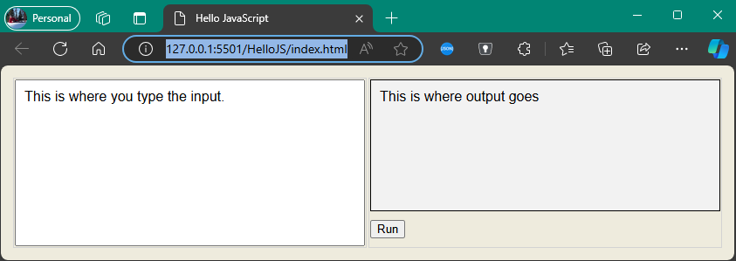
Coding in JavaScript – The Basics
Write your first JavaScript program
the Code
HelloJS web application:
The text you entered should be added as a new line here.
Input any text here
The page is organized as a table covering 100% of the page area. It contains one row and two columns:
First column: input area
Second column: output, followed by the Run button.
The Run button area is 40 pixels tall, the output area covers the rest of the column width and height.
Click this button
Can you identify which parts of the code are controlling the web page layout?

Slide 6
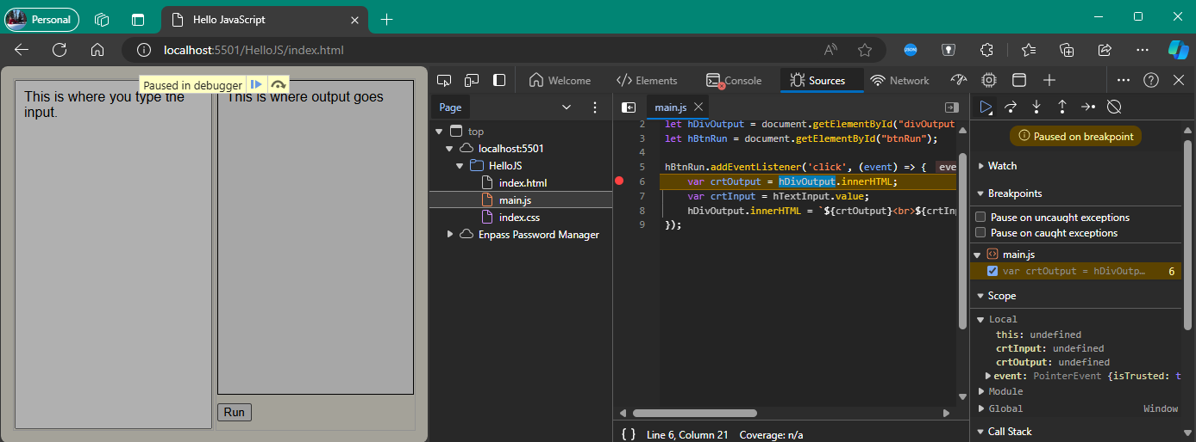
Coding in JavaScript – The Basics
Write your first JavaScript program
debugging with the Browser IDE
In the browser, press the F12 key
The Browser IDE opens up
Locate the Sources tab, click on the main.js file.
Set a breakpoint on line 6.
Click the Run button in the app.
Go step-by-step through the code.
Click Continue to resume execution.
Congratulations! You just completed your first debugging session!

Slide 7
Coding in JavaScript – The Basics
Write your first JavaScript program
… add your own code!
Transfer input instead of copy to output
Currently, input is copied to output. Clicking “Run” many times copies the same input as many times. Improve the code such that input is transferred instead of being copied: input area is set to empty once copied
Support for multiple lines
Currently, if you input multiple lines of code, they are appended to the output as one, concatenated string. Improve the code such that such that multiple lines of input are transferred as multiple lines appended to the output.
Clear the output
Currently, output grows indefinitely with each click on “Run”. Add a “Clear” button next to it: when clicking “Clear”, output content gets cleared.
Prime test
When clicking Run, check if the input is a number. If it is not, write “error” to output. If it is, write “prime number” if the number is prime, “not prime number” otherwise

Slide 8
Coding in JavaScript – The Language
Monday July 22: 2pm – 4:30pm
General structure of JavaScript projects
Similarities with other programming languages: C/C++, Python, Java
Particularities of JavaScript
What will we be coding this week?

Slide 9
Coding in JavaScript – The Language
General structure of JavaScript projects
JavaScript is mostly used for front-end web applications.
Core components of web applications:
Layout: How is the web page organized? What types of elements it contains? In what order?
Styling: How do individual elements look? What colors, what fonts, what spacing around or inside them?
Logic: How should the application behave when the user interacts with the page?
Connect the dots...
Programming Languages
Core Component
Statements about HelloJS
Cascading Style Sheets .css
Layout
When the “Run” button is clicked, the content from input is copied to the output
JavaScript .js
Styling
The background of the output is slightly darker than the one of the input text area
Hypertext Markup Language .html
Logic
The Run button is placed right under the input text area.

Slide 10
Coding in JavaScript – The Language
General structure of JavaScript projects
There are many ways to structure the source code. In its simplest form …
Layout is written in HTML
Most commonly, web app is stored in one or more HTML files (.html, .htm, .jsp, .aspx, …) downloaded from a web server and rendered by the client browser.
Less common the HTML content is generated dynamically by the web server, transferred to the client in response to a web api call, then rendered in the client browser.
Styling is written in CSS
CSS code can be hosted in its own separate files (.css), embedded as a sections in the HTML file, or in its simplest form as short attributes attached to individual HTML elements.
Logic is written in JavaScript
JavaScript code can be hosted in one or more files (.js) or embedded as sections in the HTML files.

Slide 11
Coding in JavaScript – The Language
Similarities between JavaScript and other languages
JavaScript | Python | Java/C# | C++ | C
Is a managed programming language | managed | Managed | native | Native
White spaces (blanks, tabs, new lines) are ignored | X | ✓ | ✓ | ✓
(Most) statements do not need to end with “;” | ✓ | X | X | X
Is Object-Oriented language | ✓ | ✓ | ✓ | X
Is “loosely typed” (variables do not have predefined type) | ✓ | X | X | X
Program executes top to bottom of the file in focus | ✓ | main() | main() | main()
C-style code comments (//, /* */) | X | ✓ | ✓ | ✓
Common functional programming pattern: functions/methods passed as parameters | ✓ | X | X | X
Source code example: JavaScript | Python | Java / C# | C++ | C

Slide 12
Coding in JavaScript – The Language
Particularities of JavaScript
GPT/Copilot ⟩ What are some of the most unique syntax features of JavaScript?
Automatic Type Coercion | JavaScript performs type coercion, which means it automatically converts values from one data type to another. For example, when you use the + operator with a string and a number, JavaScript will convert the number to a string and concatenate them.
Difference Between null and undefined | In JavaScript, null represents a null or empty value, while undefined indicates the absence of a value. Understanding the distinction between these two is crucial for proper programming.
Difference between == and === | The strict equality operator checks both value and type, whereas the loose equality operator only compares values. It’s essential to use the appropriate one based on your requirements.
Function Hoisting | JavaScript hoists function declarations to the top of their containing scope during compilation. This allows you to call a function before its actual declaration in the code.
Variable Scoping | JavaScript has function-level scoping, which means variables declared inside a function are not accessible outside of it. The introduction of let and const keywords in ES6 improved block-level scoping.
The Global Object | In browsers, the global object is window. Variables declared without the var, let, or const keywords become properties of the global object. Be cautious when using global variables to avoid unintended side effects.

Slide 13
Coding in JavaScript – The Basics
Write your first JavaScript program
research with GPT/Copilot prompts
GPT/Copilot ⟩ I’m writing a JavaScript program…
Transfer input instead of copy to output:
How to empty the content of a textarea element?
Support for multiple lines:
I have a textarea containing multiple lines of text. How to append them to a div element such that they will be displayed as multiple lines?
Can you explain “text.replace(/\n/g, ‘<br>’)”?
Clear the output:
How to empty the content of a div element?
Prime test:
How to test if a string has a numerical value?
How to get the numerical value of such a string?
I need to write a method taking a number as parameter and returning true if the number is prime and false otherwise.

